Slide 1
False Positives

Slide 2
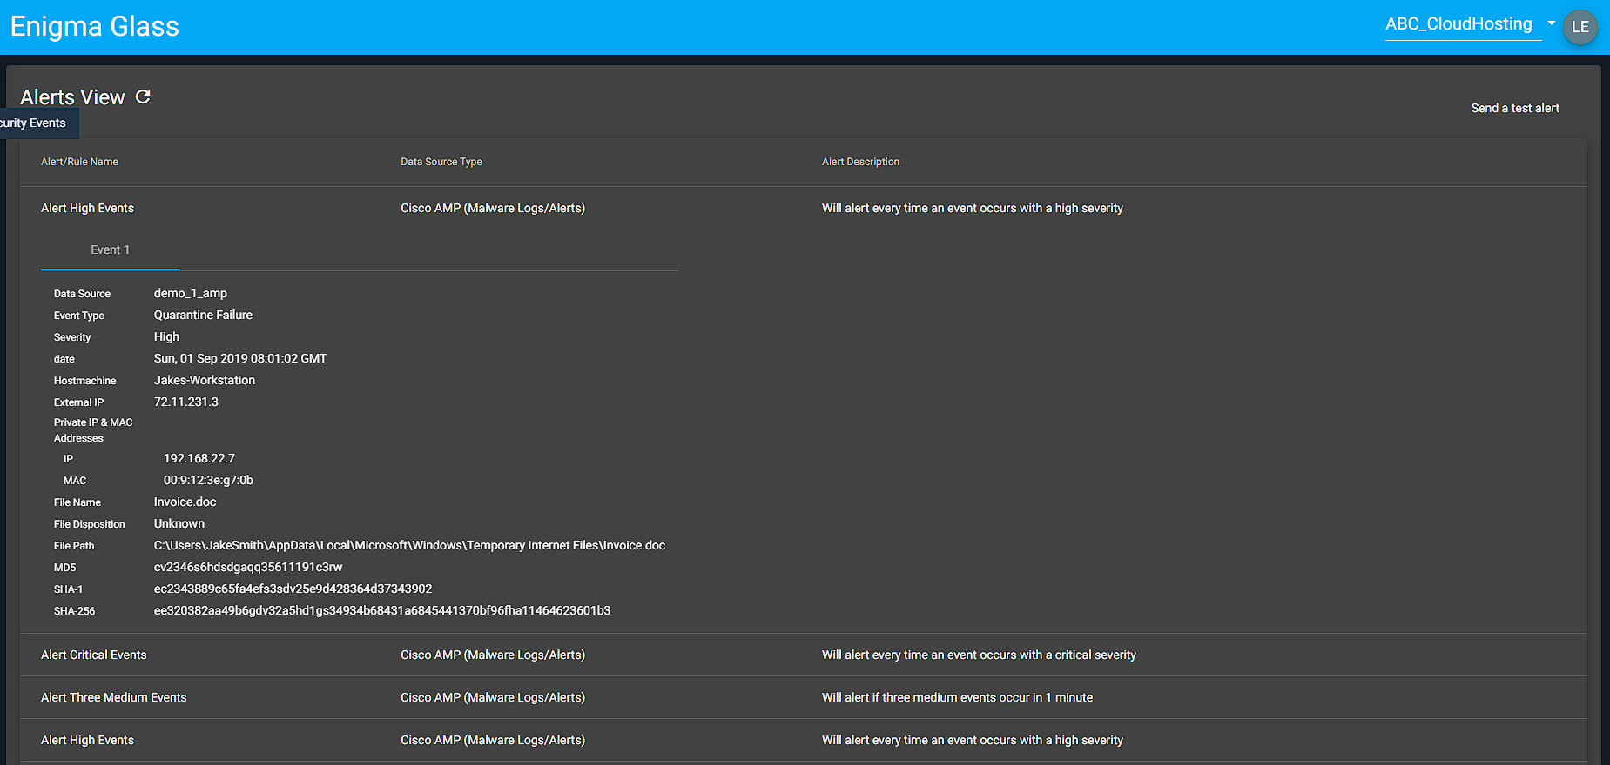
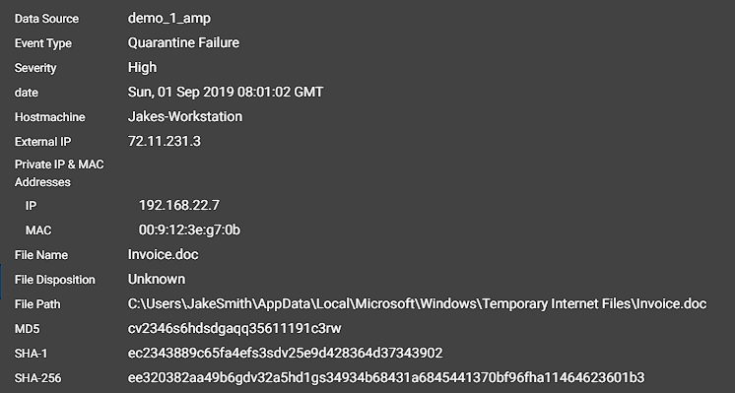
False Positive #1 ABC_CloudHosting

Slide 3
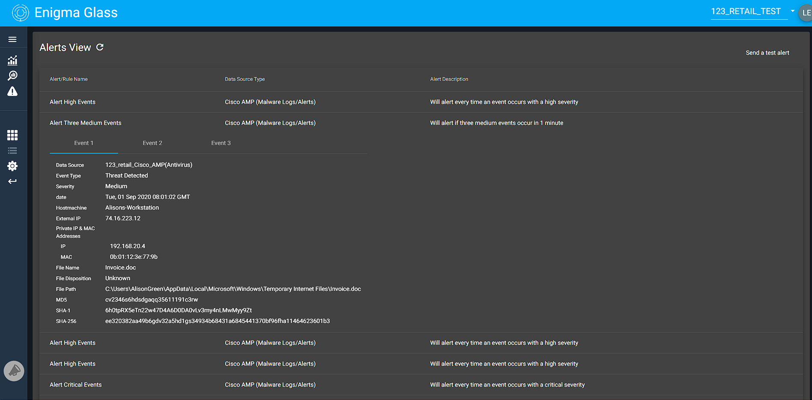
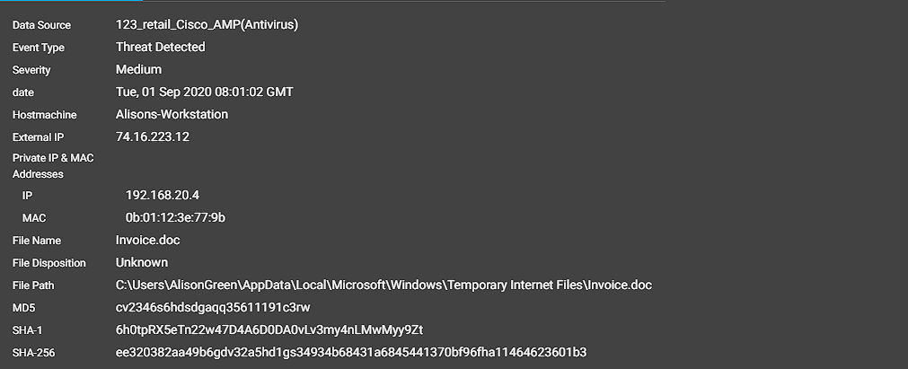
False Positive #2 123_RETAIL_TEST

Slide 4
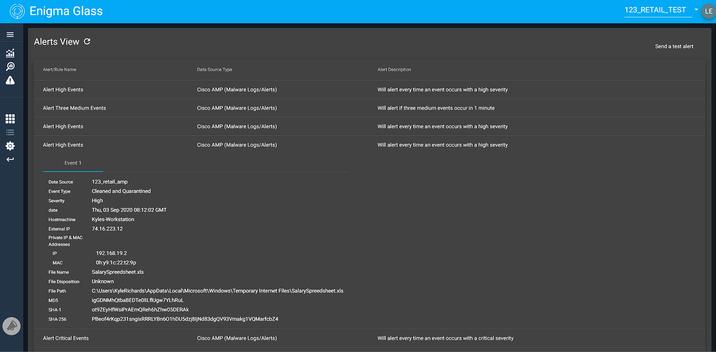
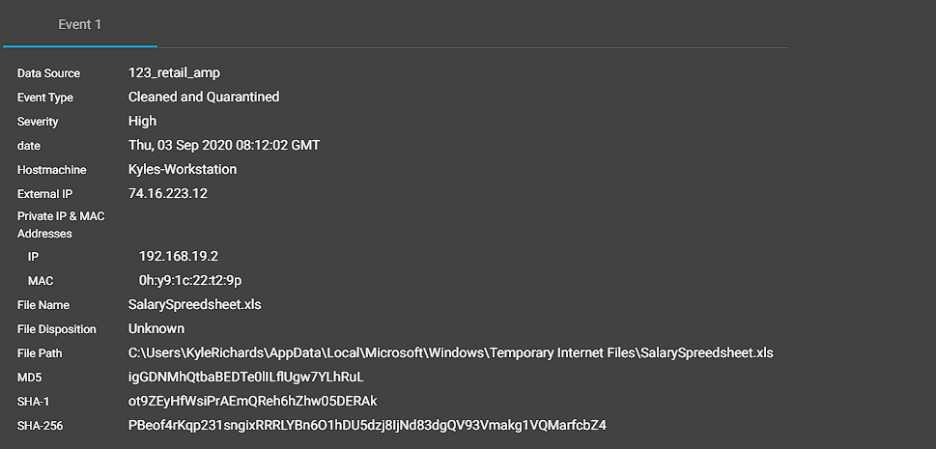
False Positive #3 123_RETAIL_TEST

Slide 5
Possible Causes
Missing security certificates
Firewall rules
Unidentified network traffic
Abnormal Data

